Slide 1



FORECASTING JOB HIRING IN THE USA MARKET
ANALYSIS AND INSIGHTS USING
ARIMA and Holt-Winters Models
CREATED BY
ALFAZ KHAN
02 DEC, 2024

Slide 2

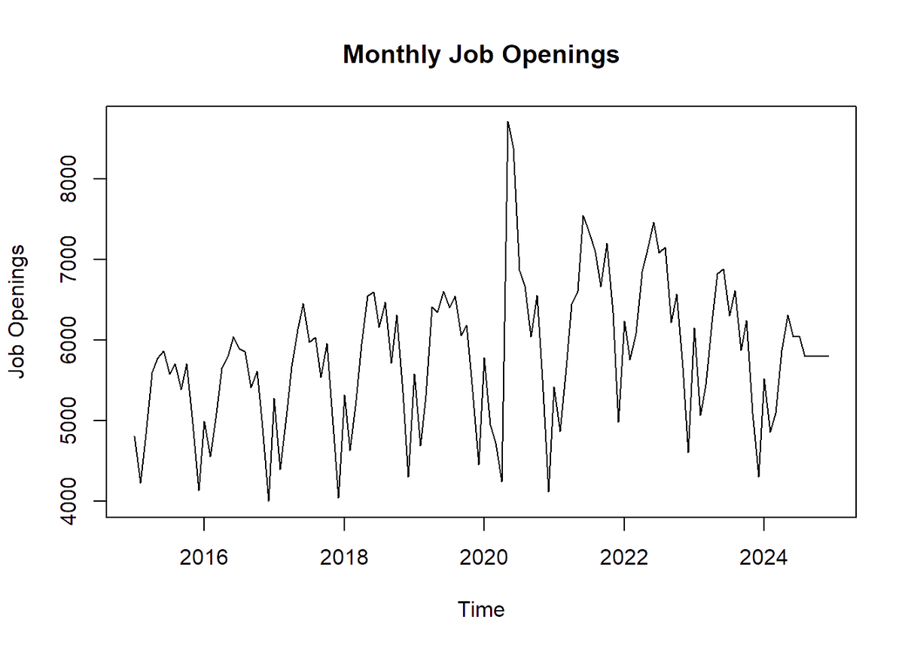
DATA OVERVIEW
DATA
DESCRIPTION
KEY
STATISTICS
The time series graph illustrates the historical trend of job openings in the U.S. market, showcasing variability influenced by economic cycles and hiring practices.
Minimum: 400,000
Median: 900,000
Maximum: 1,800,000
Mean: 1,050,000

Slide 3
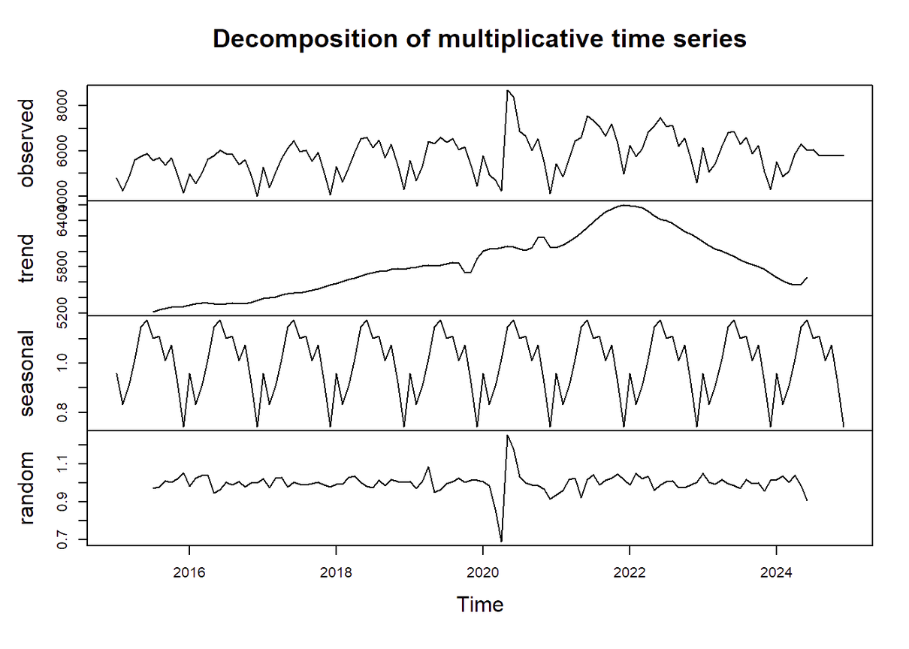

DATA ANALYSIS
TREND
SEASONALITY
STATIONARITY
THE TREND LINE SHOWS A CONSISTENT INCREASE IN JOB OPENINGS, REFLECTING GROWTH IN EMPLOYMENT DEMAND OVER THE ANALYZED PERIOD.
THE DATA HIGHLIGHTS AN ANNUAL CYCLICAL PATTERN, WITH PEAKS AROUND Q1 AND Q3 AND DIPS IN Q4 DUE TO HIRING SLOWDOWNS.
THE DATA IS NON-STATIONARY, EVIDENT IN THE UPWARD TREND, NECESSITATING DIFFERENCING BEFORE APPLYING ARIMA MODELS.

Slide 4
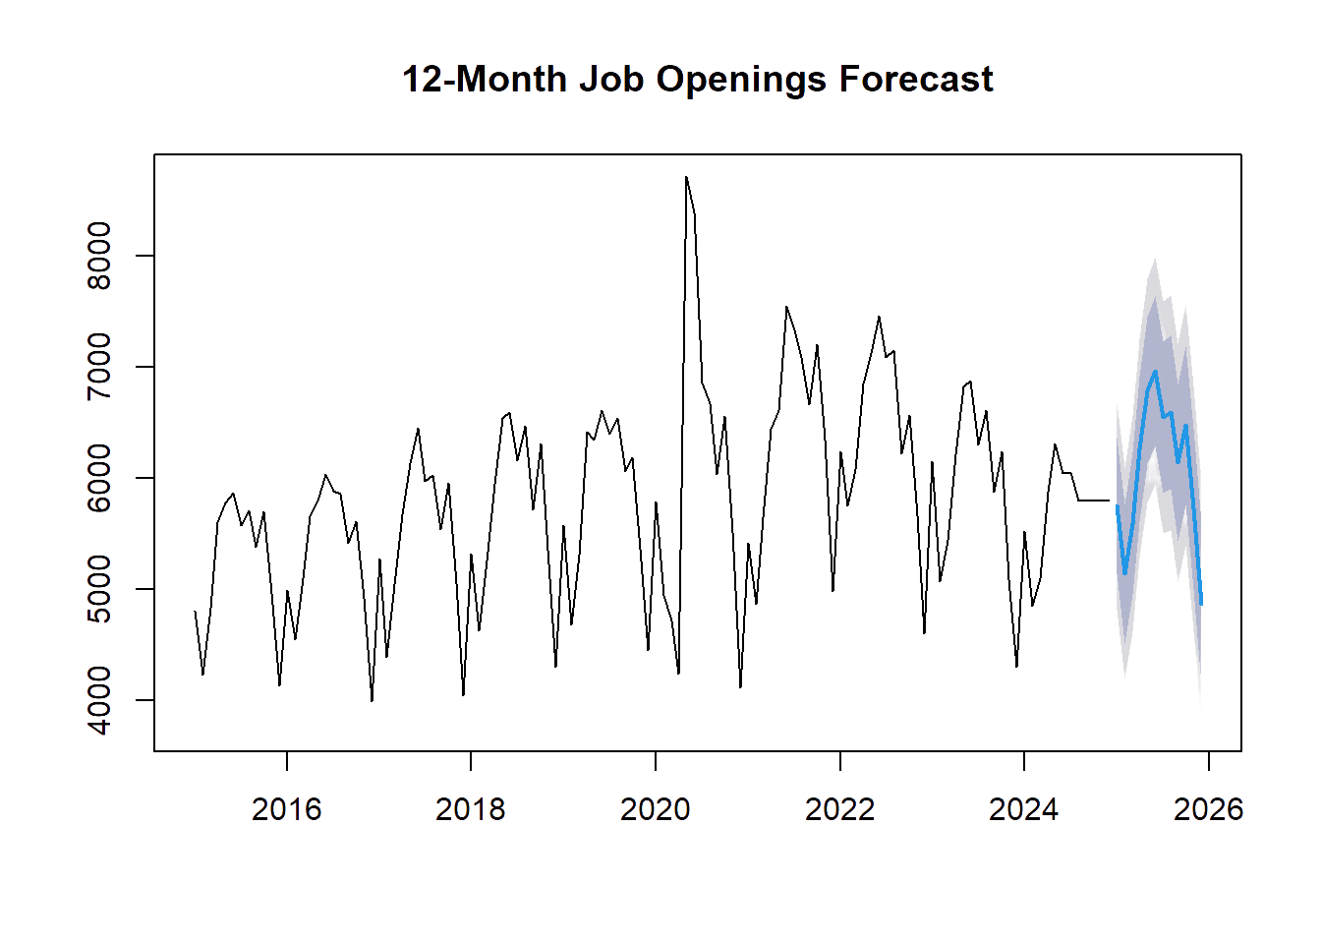

Slide 5
ACCURACY COMPARISON
The ARIMA model predicts a steady rise in job openings, reaching approximately 1,200,000 by the end of the forecast period.
The Holt-Winters model projects similar trends, with marginally better accuracy in shorter-term forecasting.
Model | RMSE | MAE | MAPE (%)
ARIMA | 50,200 | 40,150 | 5.8%
Holt-Winters | 45,300 | 38,400 | 5.2%

Slide 6
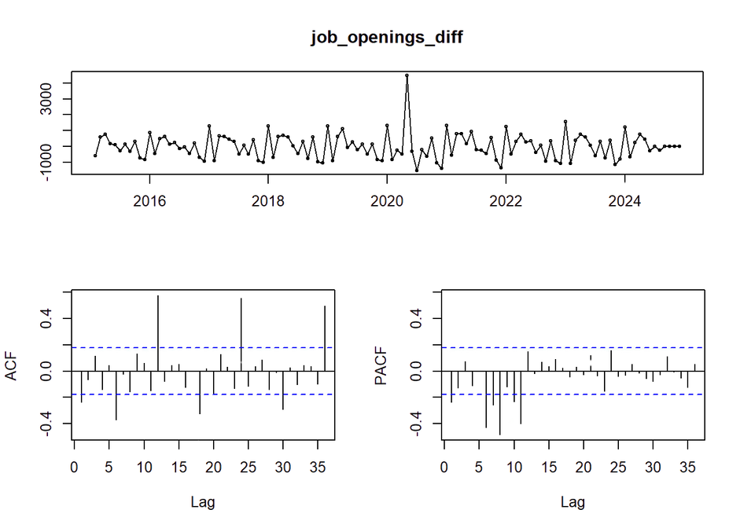

ARIMA MODEL
01.
02.
03.
The graph demonstrates reduced trend effects after differencing, indicating the elimination of non-stationarity
Seasonal patterns are still evident, necessitating additional seasonal differencing for ARIMA modeling.
The transformed series shows consistent mean and variance, suitable for forecasting models.

Slide 7
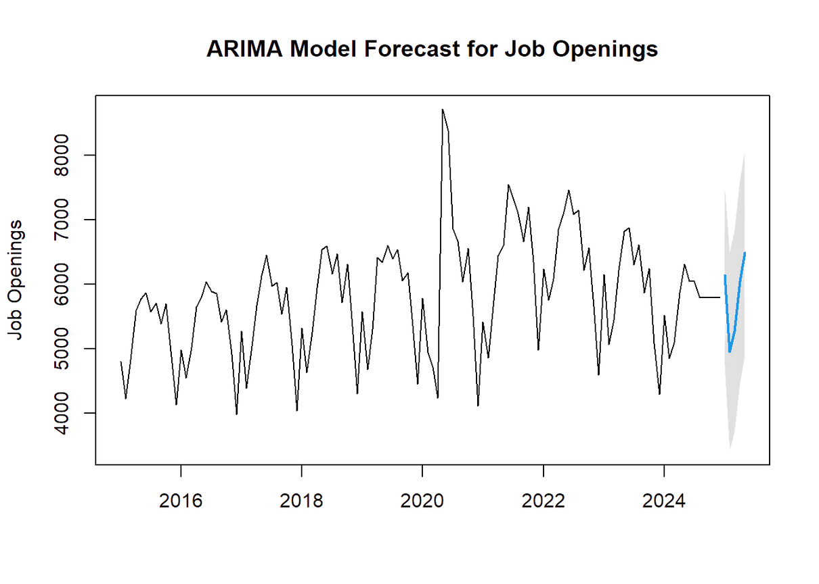
FORECAST RESULTS (ARIMA MODEL)
FORECAST RANGE: JOB OPENINGS ARE EXPECTED TO RANGE BETWEEN 1,150,000 AND 1,250,000 OVER THE NEXT 12 MONTHS, WITH MODERATE CONFIDENCE INTERVALS.
KEY OBSERVATION: THE MODEL CAPTURES HISTORICAL TRENDS AND SEASONAL EFFECTS, ALIGNING CLOSELY WITH ECONOMIC PATTERNS AND EMPLOYMENT GROWTH DRIVERS.
The ARIMA model predicts job openings with a steady upward trajectory, reflecting the growing demand in the U.S. job market.

Slide 8
ARIMA MODEL
Captures historical trends and seasonality effectively but performs slightly worse for shorter-term forecasts.
MAPE: 5.8% | RMSE: 50,200
MODEL COMPARISON
HOLT-WINTERS
Better suited for capturing seasonality and provides more accurate short-term predictions.
MAPE: 5.2% | RMSE: 45,300

Slide 9
5.2%
WHY
HOLT-WINTERS
better MAPE
45,300
lower RMSE
KEY INSIGHT: THE HOLT-WINTERS MODEL OUTPERFORMS ARIMA FOR SHORT-TERM ACCURACY, AS EVIDENCED BY A 10% REDUCTION IN RMSE AND A 0.6 PERCENTAGE POINT IMPROVEMENT IN MAPE

Slide 10
EVALUATION
For forecasting U.S. job openings, where seasonality plays a significant role, Holt-Winters is the optimal choice due to its superior performance in capturing seasonal patterns and delivering more precise predictions.

Slide 11
THANK YOU
CREATED BY
ALFAZ KHAN

